Slide 1
Research Applications
INFONETICA TRAINING 2025
Research & Innovation Team
research@stjames.ie

Slide 2
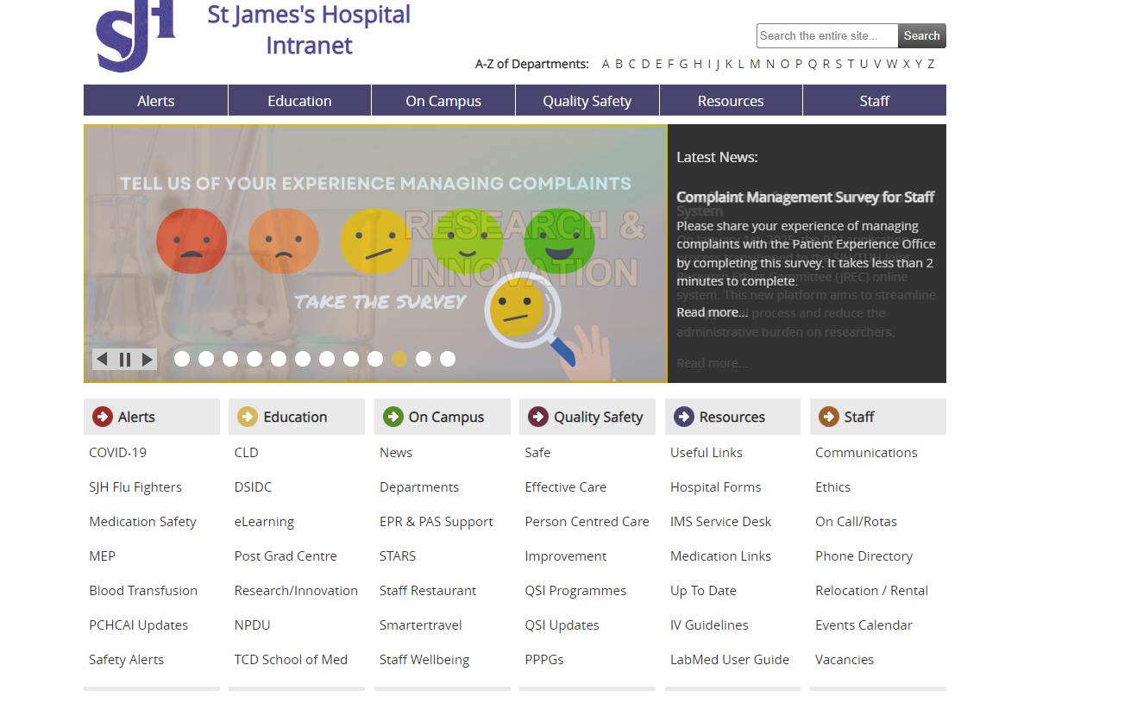
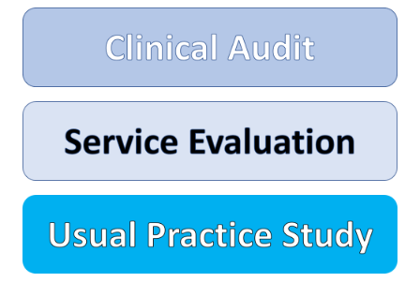
QUALITY IMPROVEMENT = QSID
From August 2024 R&I no longer accepts Quality Improvement(QI) projects. They are instead registered with QSID, through the below link.
Clinical Audit - St James's Hospital
Intranet Page Quality Safety Effective Care Clinical Audit

Slide 3
INTRODUCTION
To carry out research in St James’s Hospital (SJH) researchers must be granted;
Ethical approval (from Joint Research Ethics Committee (JREC) or National Research Ethics Committee (NREC))
AND
Hospital approval via the Research & Innovation Office
R&I applications will now be submitted through Infonetica, the same platform as JREC applications. The R&I form will be a sub-form of the JREC form.
Benefits:
The two forms are connected, i.e. your responses to questions in the JREC form will automatically populate duplicate questions in the R&I form.
More streamlined application process
Both forms are available in one location, both forms are available to external researchers outside SJH campus and questions duplicated across the forms auto-populate. Eg: DPIA

Slide 4
Application Pathways – what does this mean?
Pathway 1
Pathway 2
Use this pathway when you are applying for BOTH JREC and R&I approval.
Use this pathway for Clinical Trials, Medical Device Trial, SJH Staff Studies or Clinical Trials involving Ionizing radiation that have EXTERNAL ETHICAL APPROVAL (NREC / CTIS / University Ethics)
Pathway 2 bypasses the JREC application and allows you to upload your NREC or CTIS approval letter. Examples of pathway 2 applications include:
Any regulated clinical/medical device where ethical approval is being sought from NREC or CTIS
Any study where the participants are staff only, and university ethics has been granted
Multi-site Clinical Trials involving ionizing radiation, where one site has already received ethical approval

Slide 5
Type OF studies under both Pathways
Pathway 1
Retrospective Chart Review
Observational Research Study
Translational Research Study
Device Trial - Not subject to Medical Device Regulation
Randomised Controlled Trial
Pilot Study
Feasibility Study
Hospital Staff - Survey/Questionnaire, without ethics approval
Hospital Staff - Interviews/Focus Groups
Hospital Staff - ANONYMOUS Survey/Questionnaire, without ethics approval
Patient - Survey/Questionnaire
Patient - Interviews/Focus Groups
Patient - ANONYMOUS Survey/Questionnaire
Case Study (including 5 or more patients)
Innovation Project e.g. Consultant Spark/Innovation Fund
Systematic Review

Slide 6
Pathway 2
Clinical Trial
Medical Device Trial
Clinical Trials involving Ionizing radiation
Case Study (Less than 5 Patients)

Slide 7
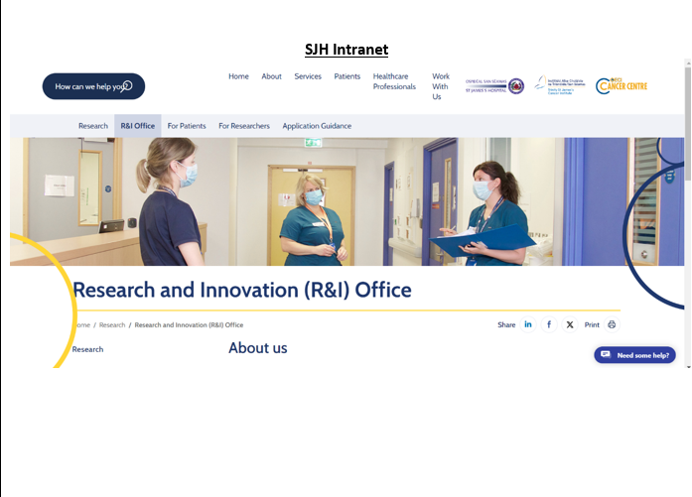
Where to find the application form ?
To get started with an R&I application, you can click the R&I Application Form link.
If you are SJH staff, the form is available on The R&I Intranet page
If you are not SJH Staff, the application is available on the public R&I website.

Slide 8
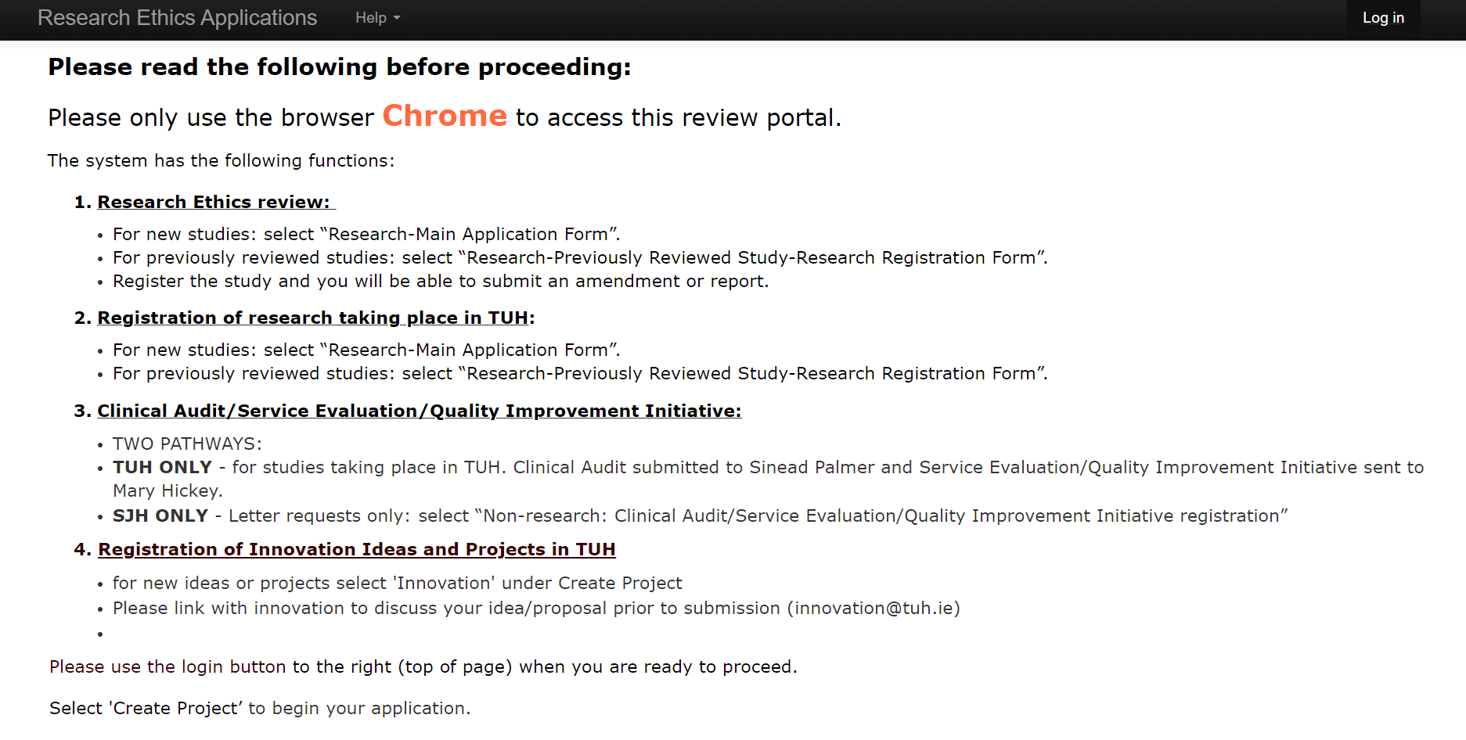
To log in or create an account, click ‘log in’ in the top right corner
https://sjh-tuh.forms.ethicalreviewmanager.com/Account/Login

Slide 9
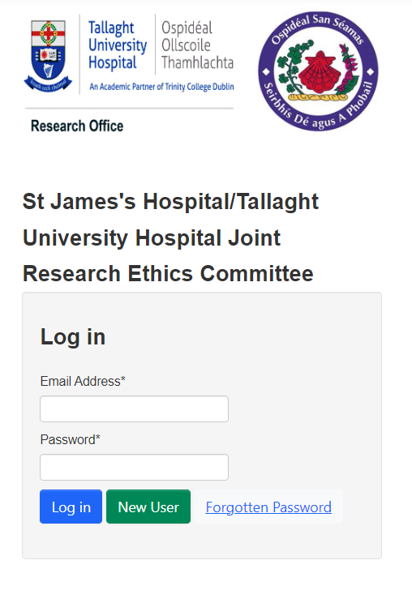
Log in or Register as a New User
Logging in
If you have already used Infonetica to submit an ethics application, you will already have an account (you can use the ‘forgot password’ function to reset this if needed).
If you are a new user, select ‘register’ to create a new account on Infonetica – PLEASE REGISTER USING YOUR SJH/TCD/TUH/INSTITUTIONAL EMAILS.
When you have provided your details and registered your account, you will receive an email inviting you to verify your account.

Slide 10
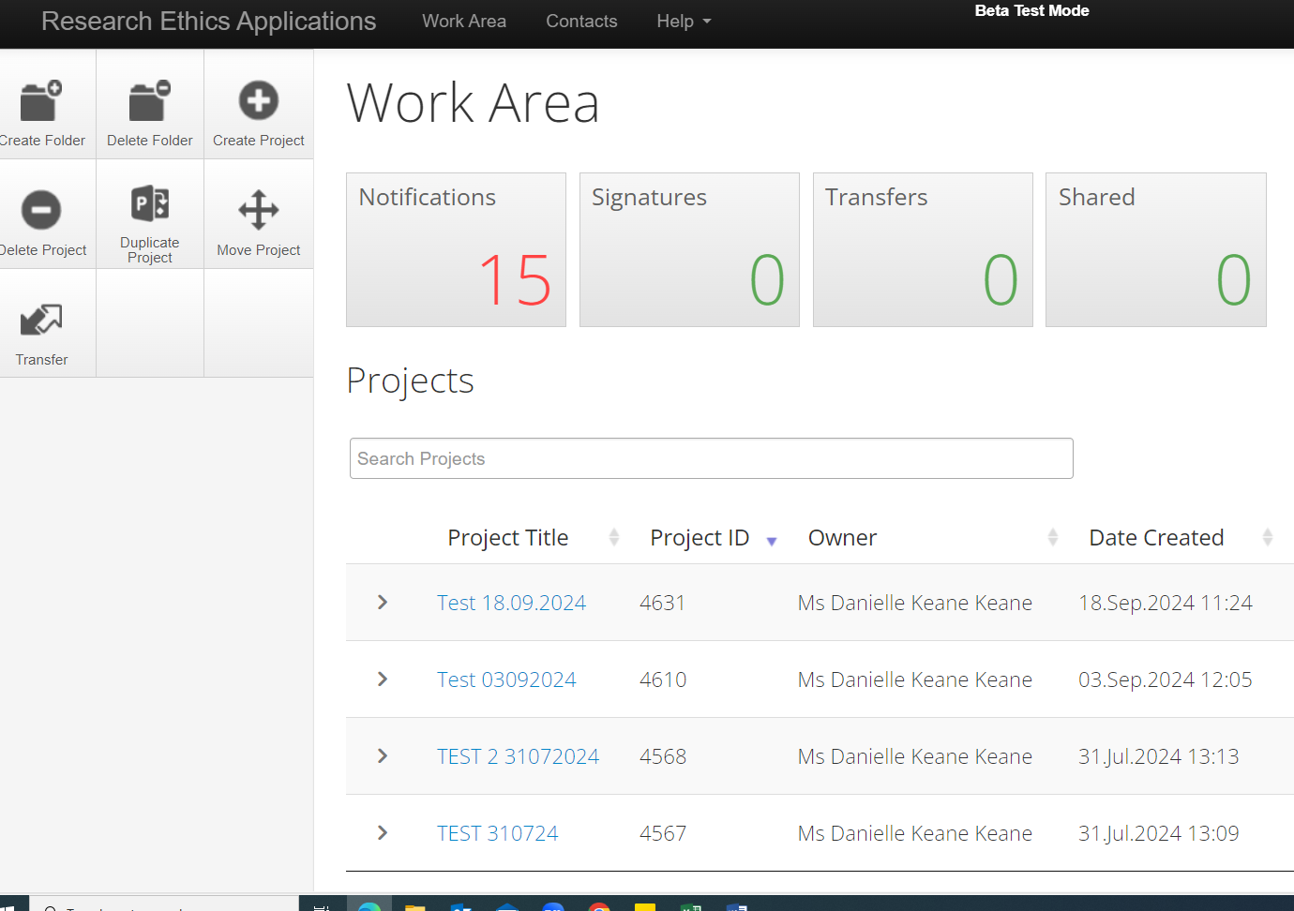
Once logged in, you will be in the Work Area.
In the work area you can:
  Create application forms
  View submitted forms
  Review forms that have been returned to you for further information, clarification of details, or with comments from reviewers.
  Share your forms with co-investigators

Slide 11
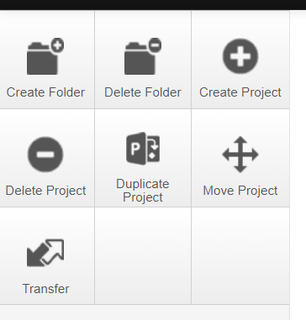
To create an application form, click ‘create project’ in the left pane.
A dialog box will open.

Slide 12
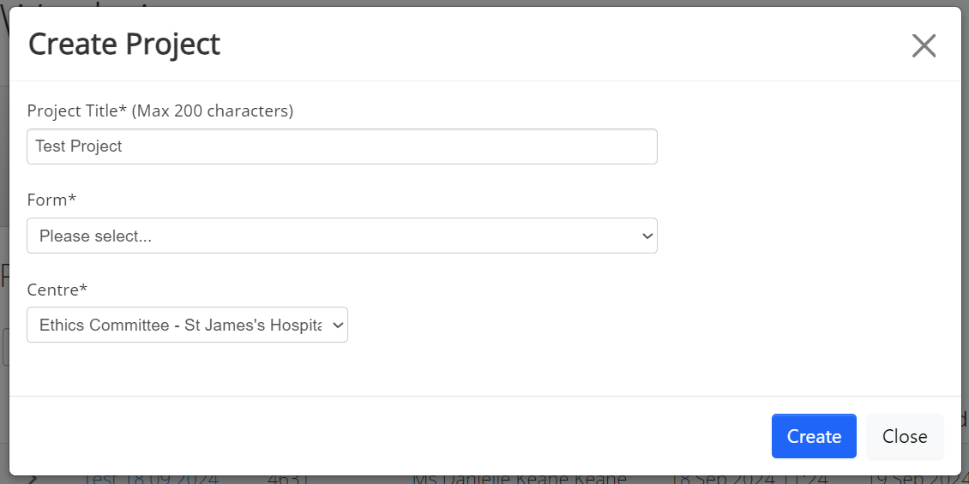
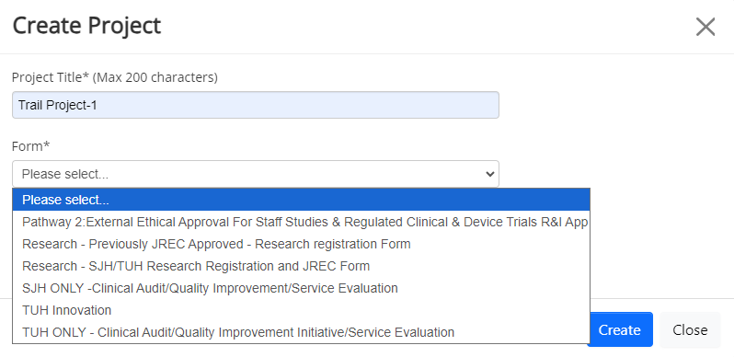
Input your project title.
2) Select the form you wish to complete from the drop-down box.
  If your study requires BOTH JREC application and an R&I application you must select ‘SJH/TUH Research Registration and JREC Form’. This will open the JREC form.
  The JREC application form must be completed and submitted before an R&I application form can be created as a Sub Form linked to your JREC submission. The R&I sub form is called Pathway 1: SJH R&I Application Form Clinical Research
  Some information provided in the JREC application form will automatically populate the R&I application form.
  If you are applying for R&I approval for a Clinical Trial, Regulated Medical Device trial that has external ethical approval e.g., NREC or CTIS OR a Clinical Trial involving Ionizing radiation & Staff Study that has external ethical approval, e.g., university ethics, you must select ‘Pathway 2: External Ethical Approval For Staff Studies & Regulated Clinical & Device Trials R&I App
Centre: Select ‘Ethics Committee – St James’s Hospital/ Tallaght University Hospital.
Press ‘Create’.
Please note that if you are applying from SJH, some of the drop-down options do not apply

Slide 13
Pathway 1
How to create an application for projects that require both JREC and R&I approval

Slide 14
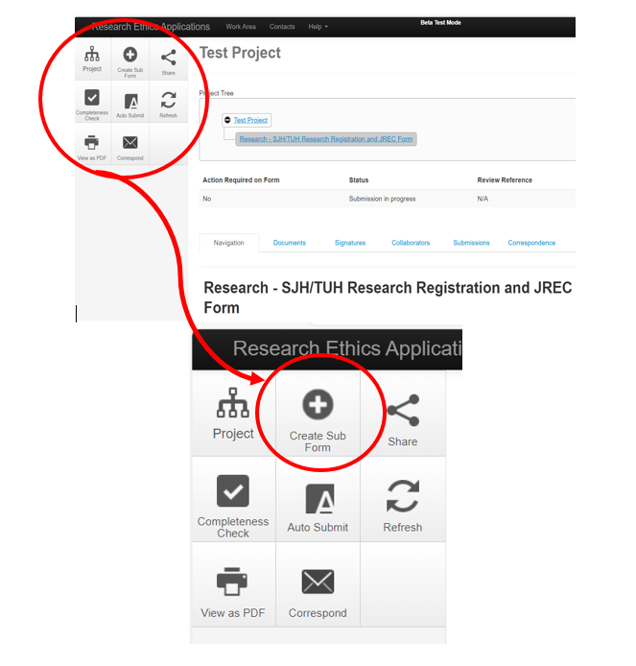
R&I Application Pathway 1: Applying for JREC and R&I approval (Non-Clinical Trial/Medical Device Trials)
There are two parts:
Complete and submit your JREC application.
Once the JREC application is fully submitted the R&I application can be created as a sub form.
To create a sub-form, click the ‘Create Sub Form’ button in the left navigation pane.

Slide 15
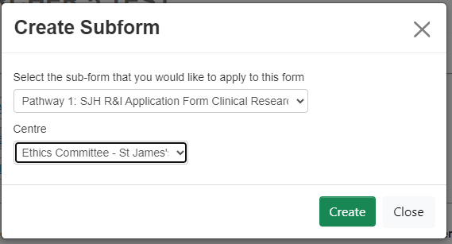
Then select ‘Pathway 1: SJH R&I Application Form Clinical
Research’.
3) Centre: Select ‘Ethics Committee – St James’s Hospital/
Tallaght University Hospital.
4) Click ‘Create’

Slide 16
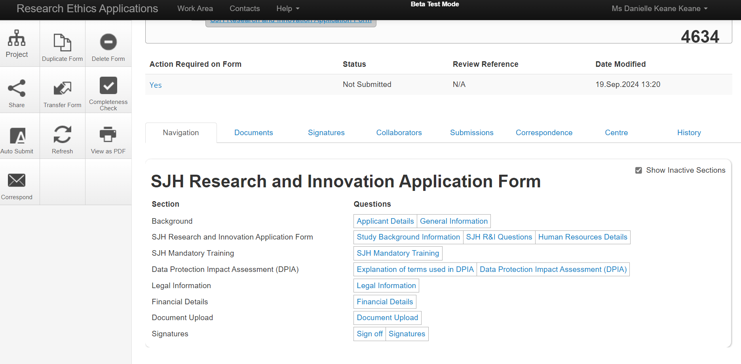

Starting your application
The R&I application form will appear as follows.
The sections to be completed are denoted by the blue font.
Many sections will have automatically populated with data from your JREC application.
To begin completing the form, select applicant details and use the ‘Next Page’ buttons to navigate through the application form.
The form questions are explained in more detail in the guidance document and by clicking on the information icons throughout the form.

Slide 17
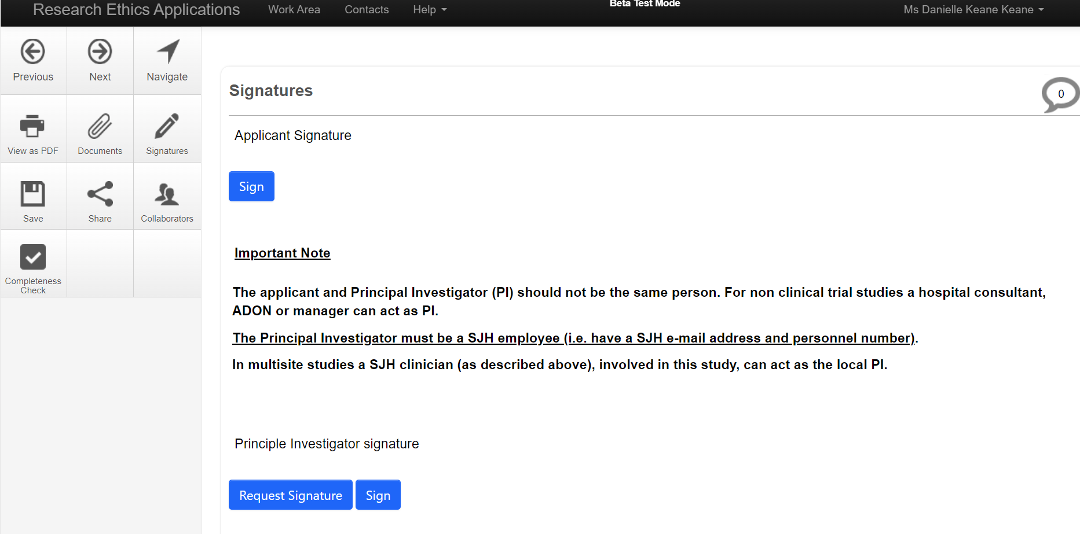
Submitting your application
Once you have completed all the sections, you will be invited to sign off and submit your application form by adding your signature. Your signature is your email and Infonetica password.
If this is the first time you have submitted this R&I application, your PI will also be required to sign off on the application. You must request your PIs signature, as you did for your ethics application.
NOTE: The R&I application form will not be submitted until the PI has provided a signature.

Slide 18
Pathway 2
How to create an application for projects that have external ethical approval but require R&I approval

Slide 19
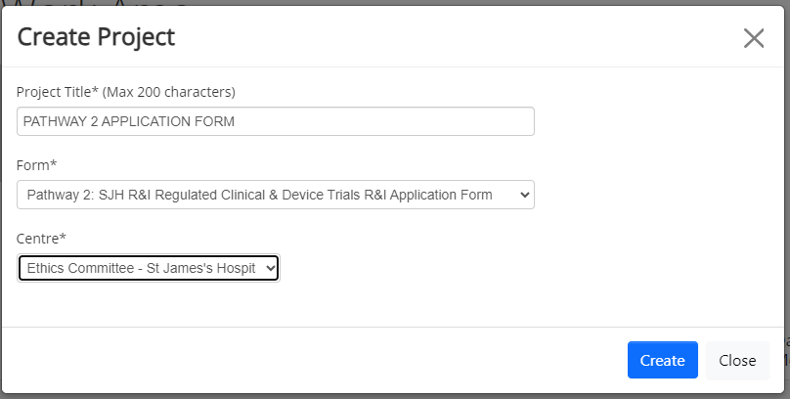
R&I Application Pathway 2: External Ethical Approval for SJH (ONLY) Staff Studies & Regulated Clinical & Device Trials
Trials that have ethical approval from the National Research Ethics Committee (NREC) or CTIS, still require R&I approval. This application can be submitted while NREC/CTIS approval is pending.
From the work area, select ‘Create Project’ in the navigation pane on the left.
Form: If you are applying for R&I approval for a Clinical Trial or Regulated Device with NREC/CTIS approval or pending approval, Clinical Trial involving Ionizing radiation or a staff study that has been granted university ethics, you must select ‘Pathway 2: External Ethical Approval For Staff Studies & Regulated Clinical & Device Trials R&I App’
Centre: You must select ‘Ethics Committee – St James’s Hospital/ Tallaght University Hospital.
Select ‘Create’.

Slide 20
Starting your application
Once created, the R&I application form will appear as follows.
The sections to be completed are denoted by the blue font.
To begin completing the form, select applicant details and use the ‘Next Page’ buttons to navigate through the application form.
The form questions are explained in more detail in the guidance document and by clicking on the information icons throughout the form.

Slide 21
Submitting your application
Once you have completed all the sections, you will be invited to sign off and submit your application form by adding your signature.
Your signature is your email and Infonetica password.
If this is the first time you have submitted this R&I application, your PI will also be required to sign off on the application. You must request your PIs signature.
NOTE: The R&I application form will not be submitted until the PI has provided a signature. This is a very important step.
You must request your PIs signature using the email associated with their Infonetica account.

Slide 22
Actions

Slide 23
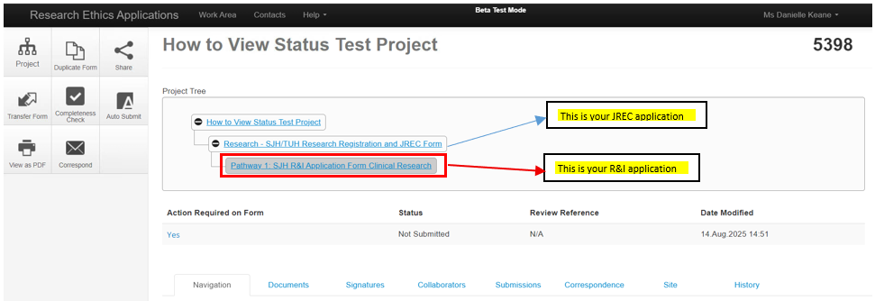
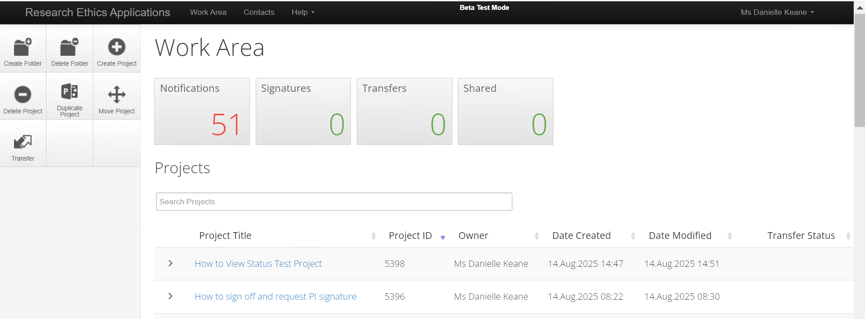
Tracking your R&I Application
You can track the status of your application at any time throughout the application process using the status bar.
To view the status bar, first select your project from your project list.
Second, and most importantly, please ensure you have selected the correct ‘branch’ from your project tree.
If you have created a pathway 1 application, the project will automatically open to your JREC application branch. Only the status of your JREC application will be visible on this branch.
You must select the R&I application branch to view the status of your R&I application.

Slide 24
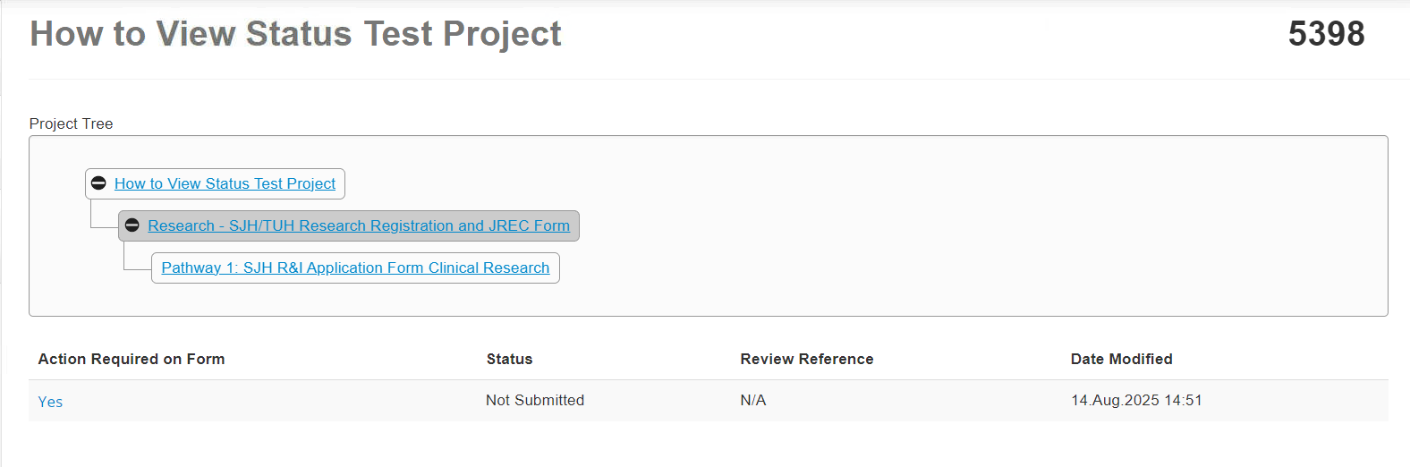
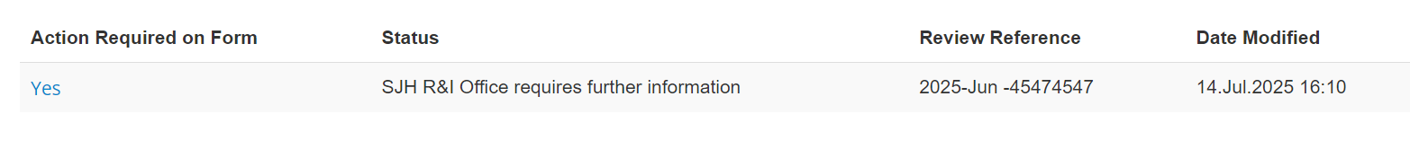
From the status bar you can see where the application is in the approval process and if any action is required from you. Actions include addressing reviewer comments, uploading documents or adding your or your Principal Investigator (PIs) signature
In this image, the status is ‘not submitted’ because the PI has not yet signed off on the application
Examples
This application has been returned by the R&I office for further information. Action is required from the applicant.
This application has been returned by the DPO for further information. Action is required from the applicant.

Slide 25
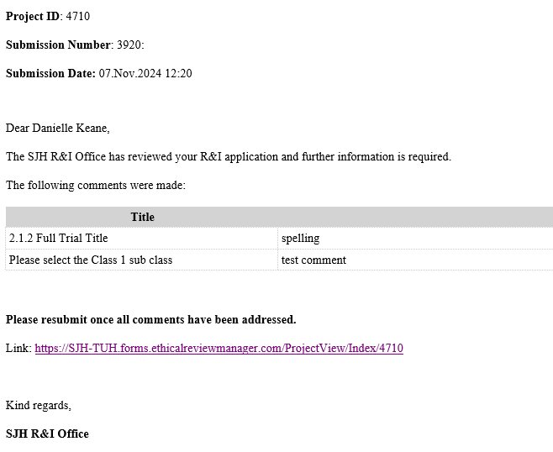
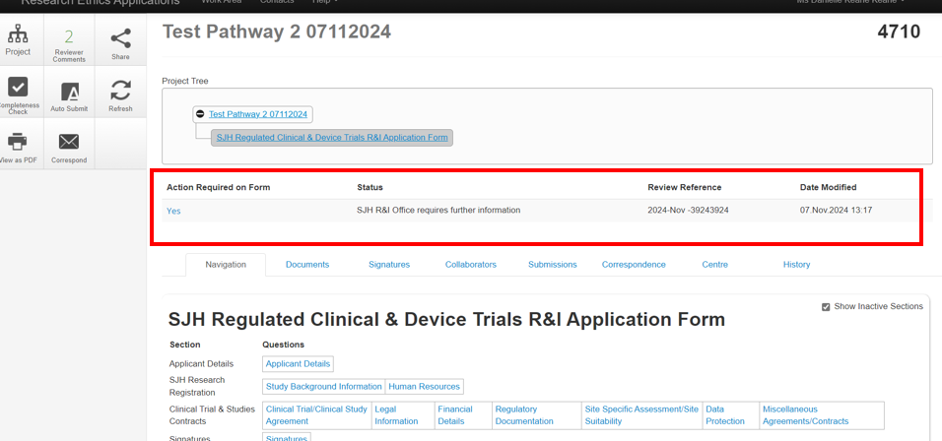
Further Information Required
When you have submitted your application, it is possible that a reviewer may request further information or leave comments to be addressed.
When this happens, you will receive an email inviting you to address this request by following the link.
When an action on the form is required from the applicant, such as further information, this will also appear on your Infonetica account when you click on the application.
Tip: You can also use this area to check the status of your application!

Slide 26
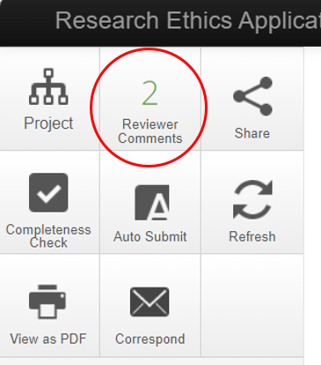
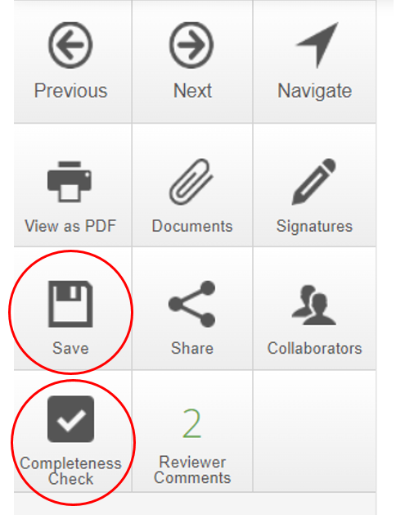
Addressing Review Comments
Reviewer comments will appear in your action pane on the left side of your screen.
Click ‘reviewer comments’ to open a dialog box containing all comments on your application.
Use this dialog box to click on a comment and address it. Please address ALL comments before resubmitting your application.
While you are addressing comments, ensure that you save all the changes that you make.
When you have addressed all comments, resubmit your application for review.

Slide 27
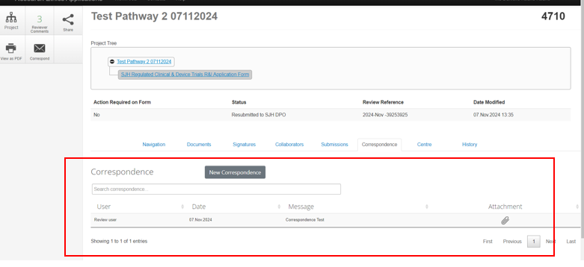
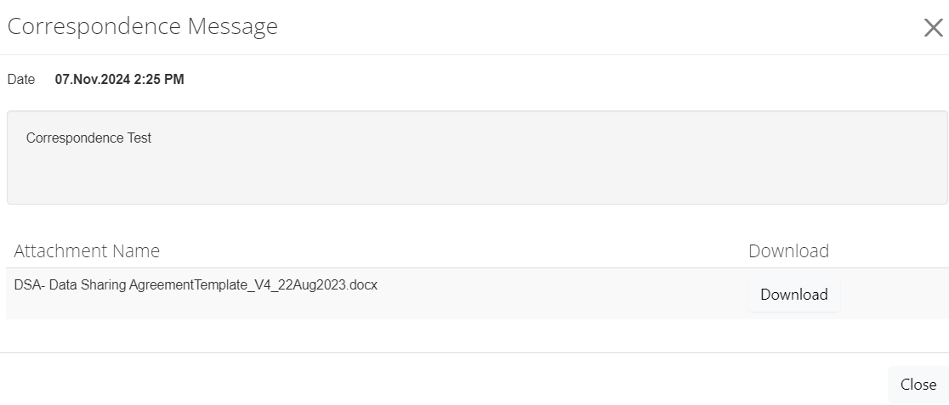
New Correspondence
Documents uploaded as part of an application are also reviewed as part of the approval process. Reviewers can leave feedback and comments on documents.
This feedback is returned to the applicant in the form of a ‘correspondence’ within Infonetica i.e. message within the system.
Download the document and address the feedback and all comments.
Re-upload the updated documents as a ‘new correspondence’.

Slide 28
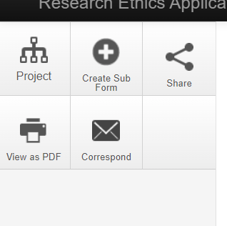
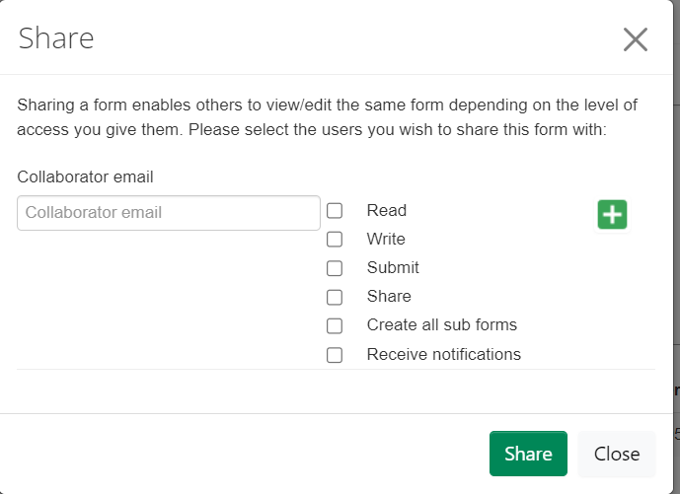
Sharing your Application Form
Applicants can share the R&I application with their team at any phase of the study.
Click ‘share ’ from the navigation pane on the left to open a dialog box containing options to enter the collaborator email and level of access to provide.
When sharing a form you can enable others to view/edit the same form depending on the level of access you give them.
Use the dialog box to enter the information and click share.
Note: the application can only be shared with registered Infonetica users.

Slide 29
Research & Innovation Application
Abbreviations
CRF: Clinical Research Facility
DPIA: Data Protection Impact Assessment
HPRA: Health Products Regulatory Authority
JREC: Joint Research Ethics Committee
NRAC: Nursing Research Access Committee
PI: Principal Investigator
R&I: Research and Innovation
SJH: St James’s Hospital
NDA: Non Disclosure Agreement
MTA: Material Transfer Agreement
DTA: Data Transfer Agreement
It is recommended to have the following documents prepared:
Garda Vetting Form/Checklist, NDA ,MTA ,DTA, Indemnity Agreements, Other applicable agreements. Templates are available in the ’help’ section of the application form. All forms can also be found on the R&I Intranet Page
Note that the late submission of these documents may cause delays.
I need to apply for R&I APPROVAL.
Go to Joint Research Ethics Committee (JREC) Webpage.
I already have:
Clinical Trial Information System Approval (CTIS)
OR
NREC Approval
OR
Local/University Ethics Approval
JREC Approval required/previously obtained
Yes
Create/ Select the JREC Application relevant to your R&I Application, The JREC must be fully submitted but does not need to be fully approved before beginning the R&I Application.
(Pathway 2)
External Ethical Approval For Staff Studies & Regulated Clinical & Device Trials R&I Application
(Pathway 1)
Create the SJH R&I Application Form Clinical Research as a sub form of your JREC form
Select the study type most suitable to your project. Staff Survey / Clinical Trial/ Medical Device Trial

Slide 30
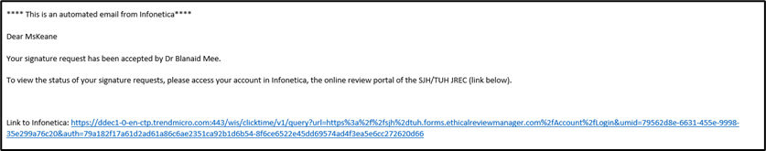
Complete all relevant sections
Complete all relevant sections
Applicant Signature / Request PI Signature
Applicant Signature / Request PI Signature
Principal Investigator Sign Off
It is important to note that until you receive this approval, the form cannot proceed to submission.
Form Submitted
Once the form is submitted successfully, you will receive the below automated email. It is important to note that until you receive this email, the form has not been submitted to the R&I Office.

Slide 31
After Application is Submitted
R & I Review
The NRAC reviews applications, where nurses and/or healthcare assistants are subjects in the study. https://www.stjames.ie/intranet/oncampus/departments/nursingresearch/
If Applicable, Nursing Research Access Committee Review
If additional information is required by R&I, the form will be returned with comments.
In such cases, please address all comments and resubmit your application for further review
If Applicable, Clinical Research Facility Review
CRF reviews the application, when the study be run in tandem with the Wellcome HRB Clinical Research Facility.( https://www.sjhcrf.ie/ )
Data Protection Officer Review
Applicant Sign Off required for application resubmission following requested changes from R&I/DPO/Legal.
If additional information is required by the DPO, the form will be returned with comments.
In such cases, please address all comments and resubmit your application for further review
Legal Review
Chief Executive Officer Sign Off
Final R&I Sign Off

Slide 32

Questions?
For further information, contact the Research & Innovation Office -
Email: research@stjames.ie
Phone Number: 01 – 415 1978

